Slide 1


WEBINAR
OPEN ACCESS CHALLENGES
FOR SMALL PUBLISHERS
August 25, 2022

Slide 2


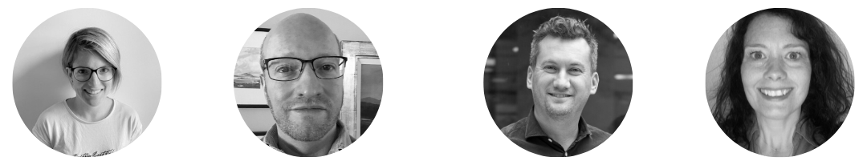
CHRONOSHUB WEBINAR
OPEN ACCESS CHALLENGES
FOR SMALL PUBLISHERS
Our moderator
White Horse Press
Common Ground Research Networks
Wisconsin University Press
Romy Beard
James Rice
Phillip Kalantzis-Cope
Toni Gunnison
Head of Publisher Relations
ChronosHub
Partner
Chief Social Scientist
Journals Manager

Slide 3

CONTENT
The agenda for today
1
3
Short presentations
What's next
2
4
Discussion of Challenges
Q&A
Notes:
This slide is a part of a series 2/2

Slide 4


Journals
67 journals – 53 hybrid, 14 fully open access
Our Data
2021: 843 articles published in total – 130 open access (15.4%)
2022: 410 articles published in total – 75 open access (18.2%)
COMMON GROUND RESEARCH NETWORKS
OA business models
Green OA for all titles; Gold OA for Spanish Language; Hybrid Open Access; Membership; (attempting) Read & Publish Agreements and Subscribe to Open
Overview
Main Drivers for OA:
Forecasting the future: organizational sustainability, considering our authors and research communities
Other OA initiatives Your Organisation is Involved In:
Internally: “Open Presentations” – for our Research Network conferences on our CGScholar.com platform (developed by the Common Ground Media Lab)

Slide 5
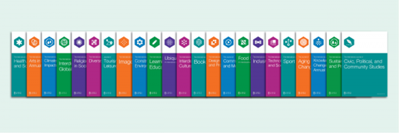

COMMON GROUND RESEARCH NETWORKS
The Front Line
Our dedicated, professional (but small) editorial and production staff need to be OA translators in disciplinary (arts, design, humanities and social sciences) or international scholarly communities with differing understandings and mandates for OA
New Data Infrastructures
The collection and sharing of data to OA indexing databases and journal comparison platforms present significant labor and cost challenges -- and, at times, a Kafkaesque experience!
The Open Community
Support from the new institutions of OA; the competitive landscape in the "business" of OA -- who might be privileged? What's the place for small publishers?
Small Publisher Challenges

Slide 6


WHITE HORSE PRESS
Overview
5 journals (4 hybrid, 1 fully OA, new OA journal launching 2023)
4-5 books/year
In 2021, 7 of 79 research articles were OA (9%).
In 2022 so far, 9 of 44 = 20% OA.
Current OA models:
- Green OA for all journals – a start, but not sufficient.
- APCs in hybrid journals – minimal uptake; not fully equitable.
- Full sponsorship – convenient, but hard to replicate and potentially unstable.
- Subscribe to Open – trying for one journal in 2023... promising!
Other OA models:
- Read & publish agreements – seem impossible at our small scale.
- APC-led models – we hope to avoid charging APCs, if possible.
- Consortia fundraising – hoping to develop this (akin to e.g., JISC's OACF).
​

Slide 7
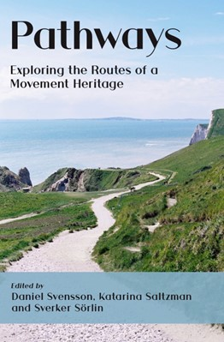
WHITE HORSE PRESS
Main Drivers for OA
Ambition to improve outcomes:
Broaden access for readers.
Boost profile for authors.
Improve profile and metrics for the journals.
Increase impact in the fields and causes we support.
Business continuity:
Adapt to fundamental change in industry.
Prepare now, to ensure the long term survival of our business.
Other OA initiatives we are involved in, or hoping to be:
- Open Access Switchboard.
- Open Book Collective (hoping to be able to join).
- OASPA.
- Knowledge Unlatched – trying to flip backlist books.
- JISC and other library consortia – seeking OA opportunities, e.g. through OACF.
​

Slide 8
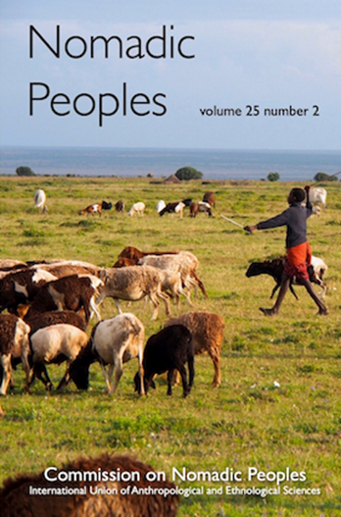
WHITE HORSE PRESS
Challenges in moving to OA
Low Capacity: ~2.5 FTE equivalents
Shifting to OA is a fundamental change to our business model.
Maintaining networks in our narrow subject areas takes much effort; but for OA we need to build networks much more widely.
High Uncertainty
OA landscape is rapidly evolving; unclear what models may prevail in a few years.
Need not to become locked in; but that's hard when small.
Unknown Sustainability
Unsure which (if any) OA models are likely to be sustainable.
Likely Variability
OA revenue seems likely to be more jumpy, less uniform than traditional publishing revenue; this presents stability risks for a very small business.
​

Slide 9

Journals
12 hybrid Humanities and Social Science journals.
Our Data
2021: 306 articles published in total – 29 open access (9.5%)
2022 to date: 320 articles published in total – 36 open access (11.3%).
Includes one full OA issue for one journal.
UNIVERSITY OF WISCONSIN PRESS
OA business models
Hybrid Open Access with Green OA available for all. Gold OA available for individual articles supported by APCs.
Overview
Other OA initiatives Our Organisation is Involved In:
In 2017–18 we published a grant-supported gold OA humanities journal. The journal lost funding, changed publishers, and has flipped to a subscription supported journal.
Editorials and section introductions are always OA for all of our journals. Supplementary materials are freely readable, but not given a CC-BY license (are not technically OA).
Our Books division is participating in the BTAA eBook Pilot.

Slide 10
UNIVERSITY OF WISCONSIN PRESS
Little funding in HSS = no substantial funder demands for OA. The majority of our authors are located within the US, where there is less funding (and funder demands) for OA.
Lack of author interest for OA. In some cases, humanities authors do not wish to publish OA, because they would like to republish (in a monograph) at a later date. The article is the research, not the product of the research.
In some cases, subscription revenue financially supports a scholarly society.
Challenges

Slide 11
Discussion of Challenges
Differences in author demands – due to funder requirements?
Staff capacity & relationships with libraries and agents
Technical demands & infrastructure
Organisation's OA mission
Org

Slide 12
What's next?
What's next for your organisation?
Need for fairer business models?
Community spirit
Audience Q&A
Notes:
Miguel – use co-author data for marketing even if not in a business model

Slide 13

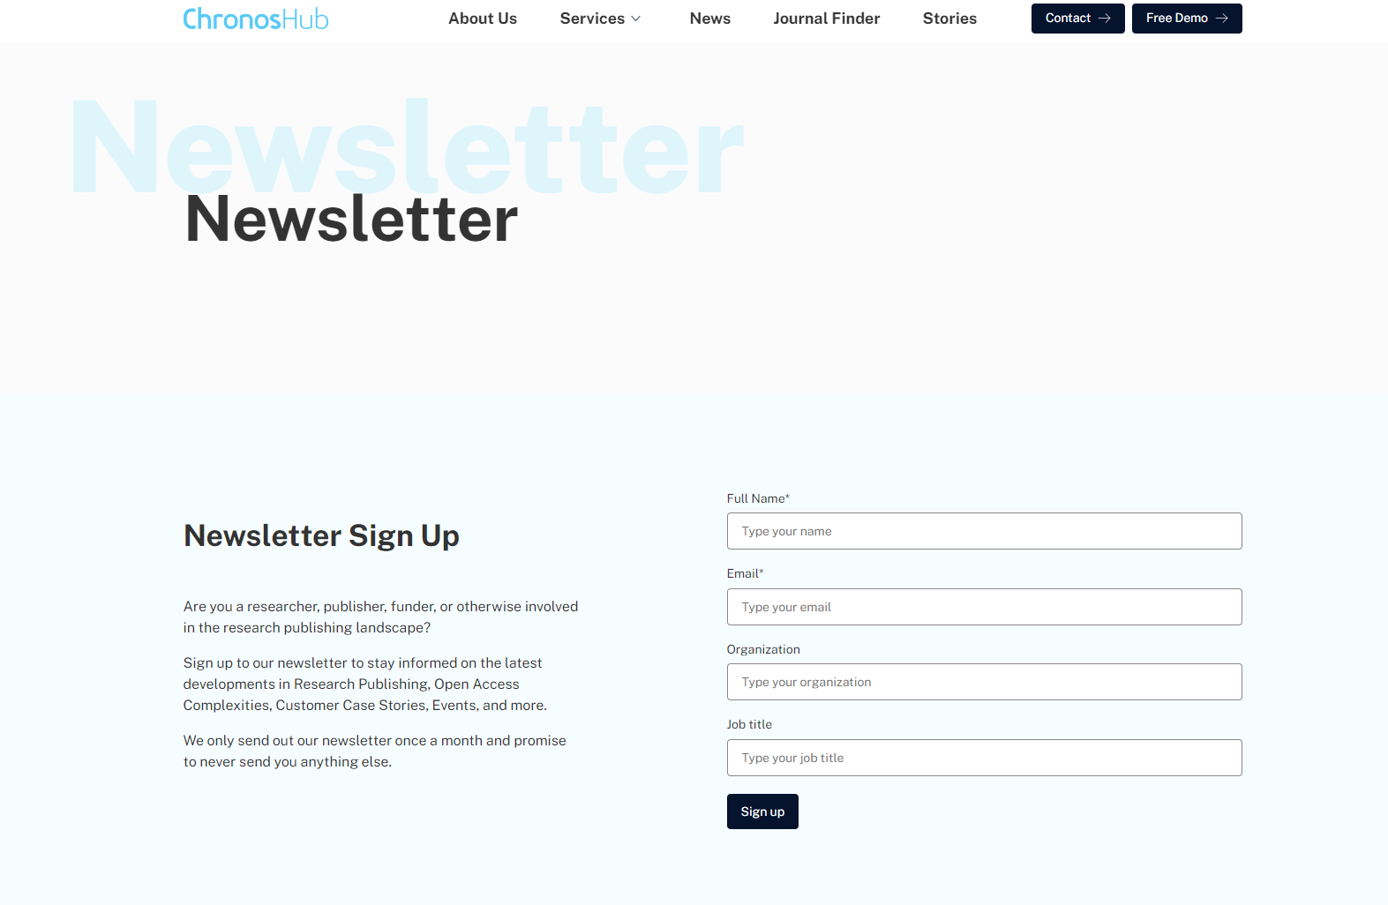
NEWSLETTER & EVENTS LIST
Sign up for our newsletter to stay informed on the latest developments in research publishing, open access complexities, customer case stories, future webinars, events, and much more.
We only send out our newsletter once a month – less is much more.
Newsletter: https://chronoshub.io/newsletter/
Event list: https://chronoshub.io/events/

Slide 14
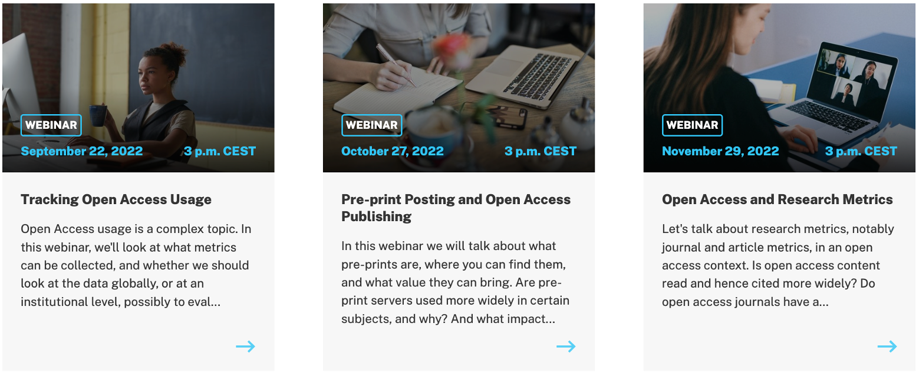
UPCOMING EVENTS

Slide 15
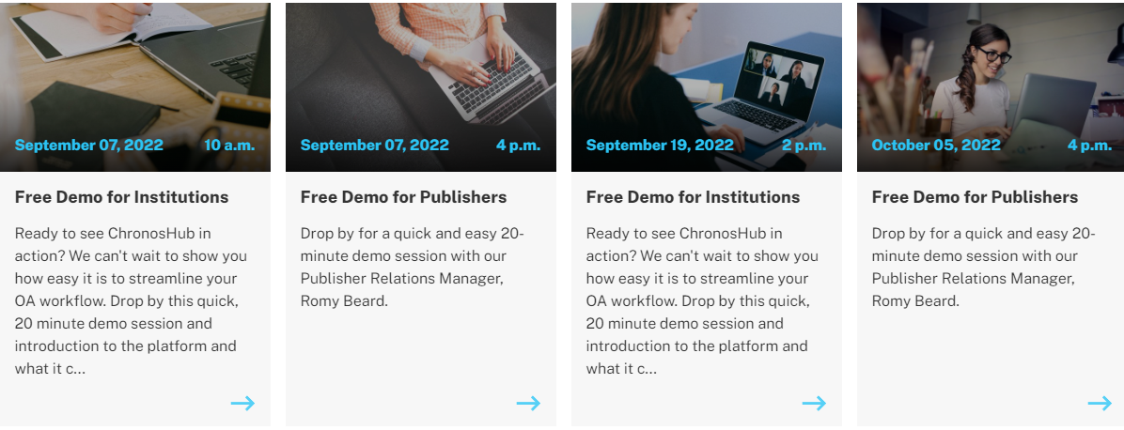
UPCOMING DEMOS

Slide 16



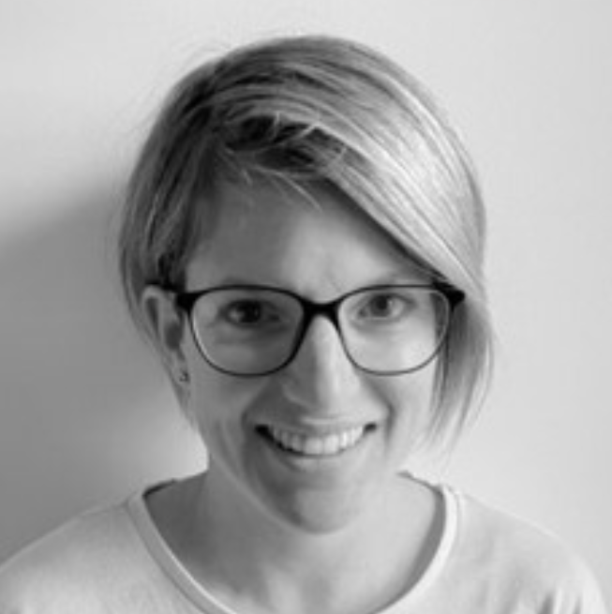

QUESTIONS
PLEASE CONNECT WITH US
@Chronoslimited
@chronoshub
@chronoshub
Romy Beard
Head of Publisher Relations
rb@chronoshub.io
Martin Jagerhorn
Head of Business Development
mj@chronoshub.io
Notes:
https://chronoshub.io/
https://www.linkedin.com/company/chronoshub/posts/?feedView=all
https://www.facebook.com/chronoslimited
https://twitter.com/chronoshub?lang=ca
Facebook: @Chronoslimeted
Andet @chronoshub

