Slide 1


WEBINAR
TRACKING OPEN ACCESS USAGE
September 22, 2022

Slide 2
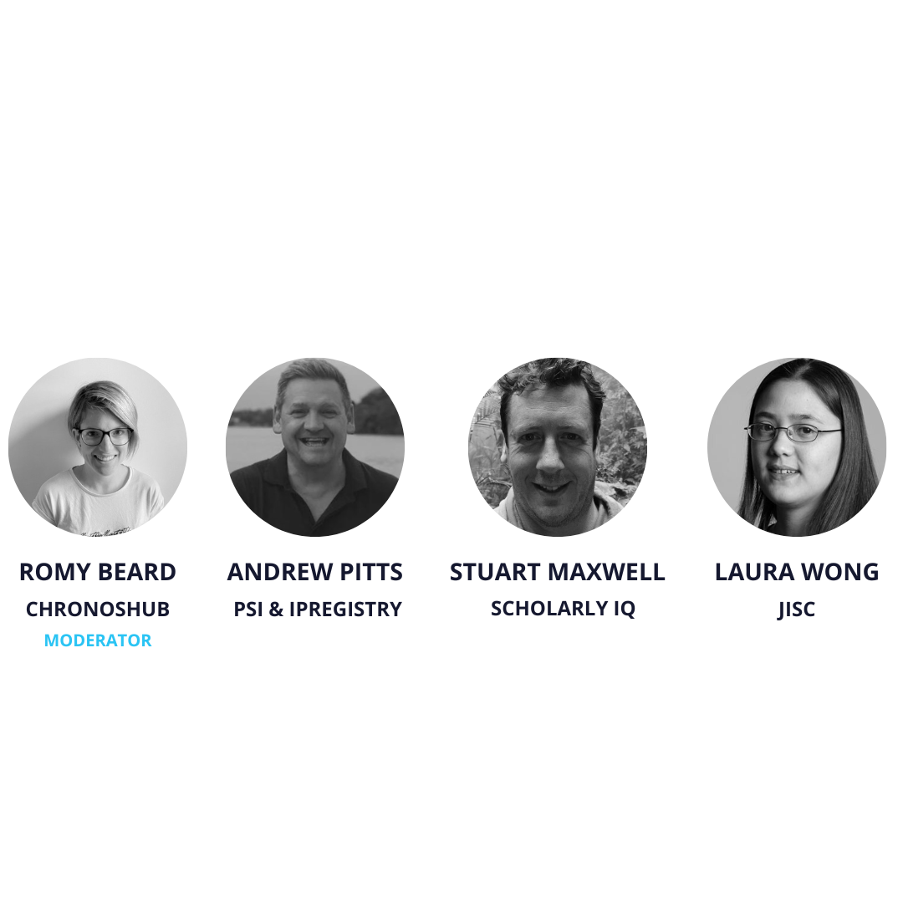

CHRONOSHUB WEBINAR
TRACKING OPEN ACCESS USAGE

Slide 3


CONTENT
The agenda for today
1
3
Short presentations
What's next
2
4
Discussion
Q&A
Notes:
This slide is a part of a series 2/2

Slide 4


Matching OA usage to institutions
PSI Metrics & theIPregistry
PSI Metrics uses the fully auditable data within theIPregistry.org to generate open access usage metrics for publishers, universities, funders and authors.
theIPregistry.org is a global repository for the IP addresses used by libraries, platforms, and publishers to authenticate access to content.
Readers are identified by their organisational affiliation only.
We do not collect, store or share any personal data as part of this process so we are completely GDPR compliant.

Slide 5
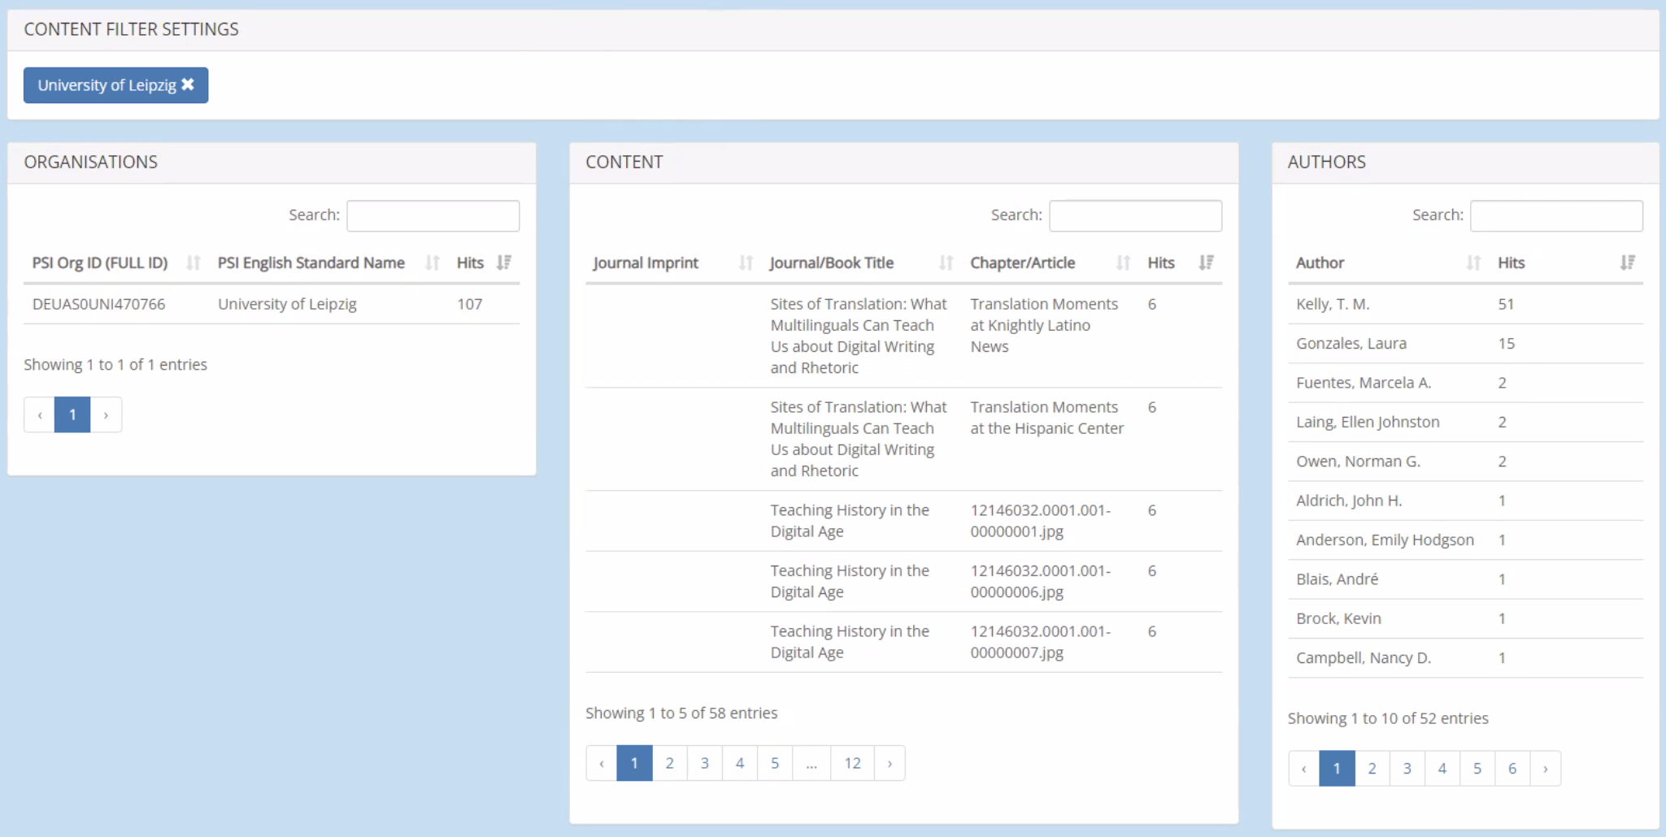
Michigan University Press
Institution report – usage from an institution

Slide 6
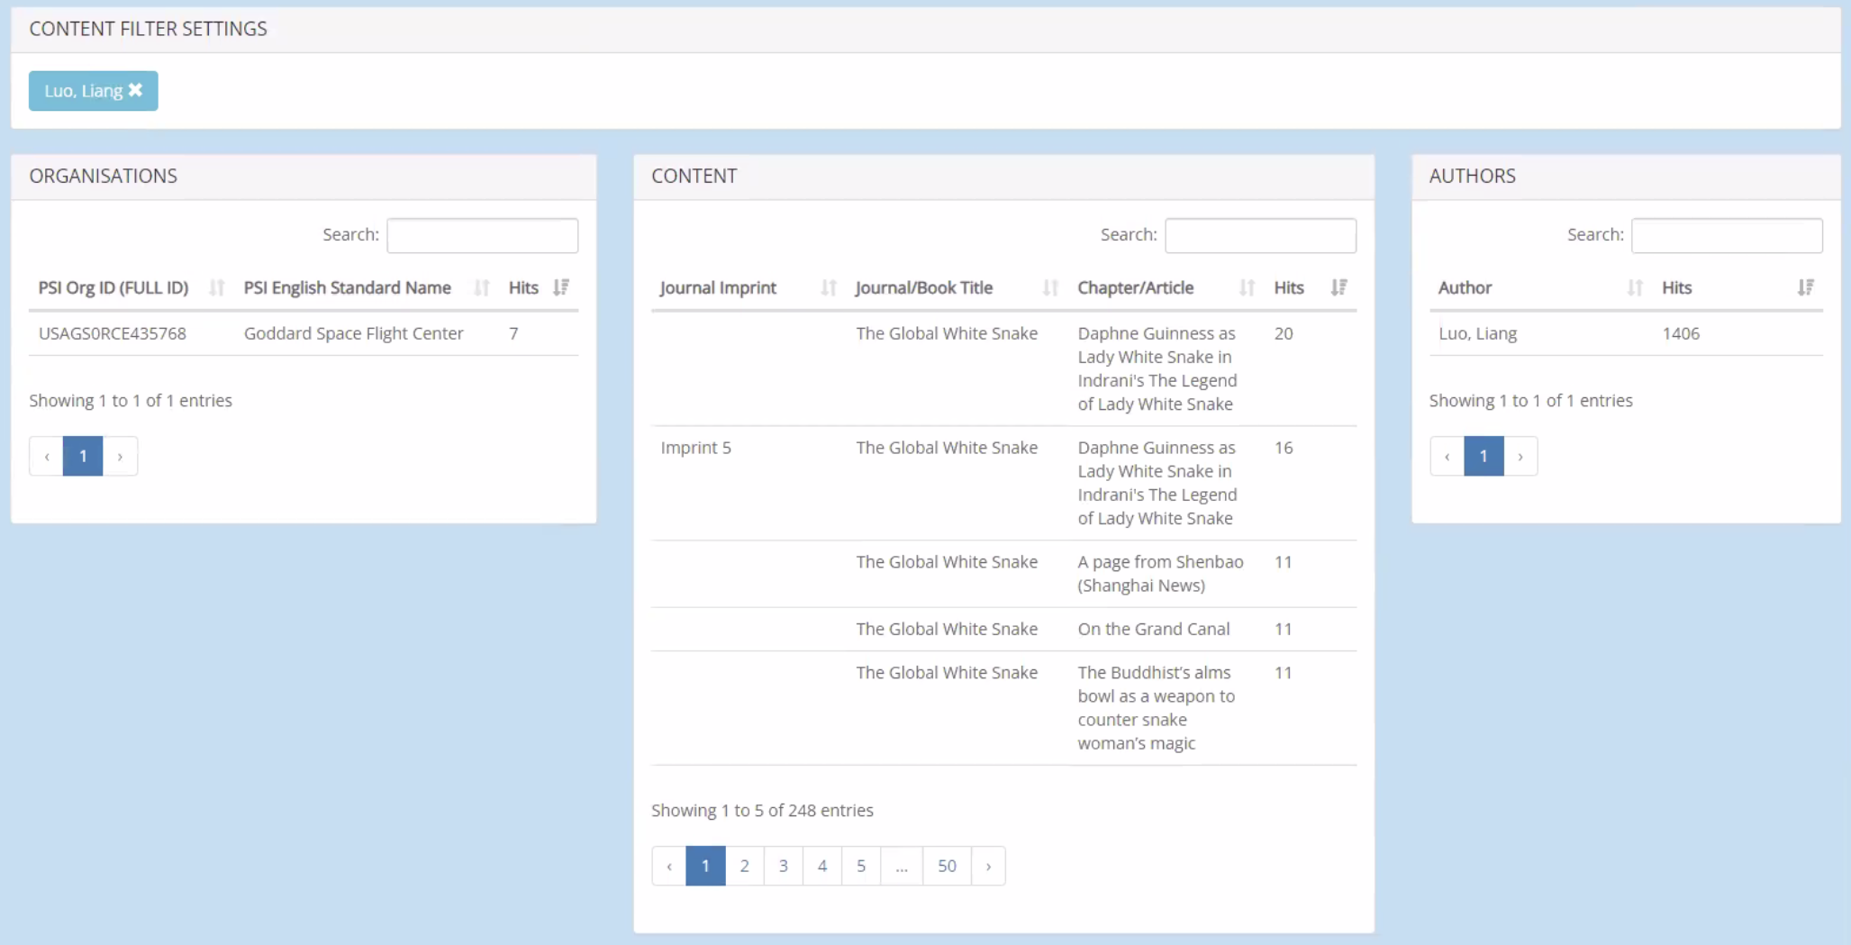
Michigan University Press
Author report – global usage on articles by author

Slide 7
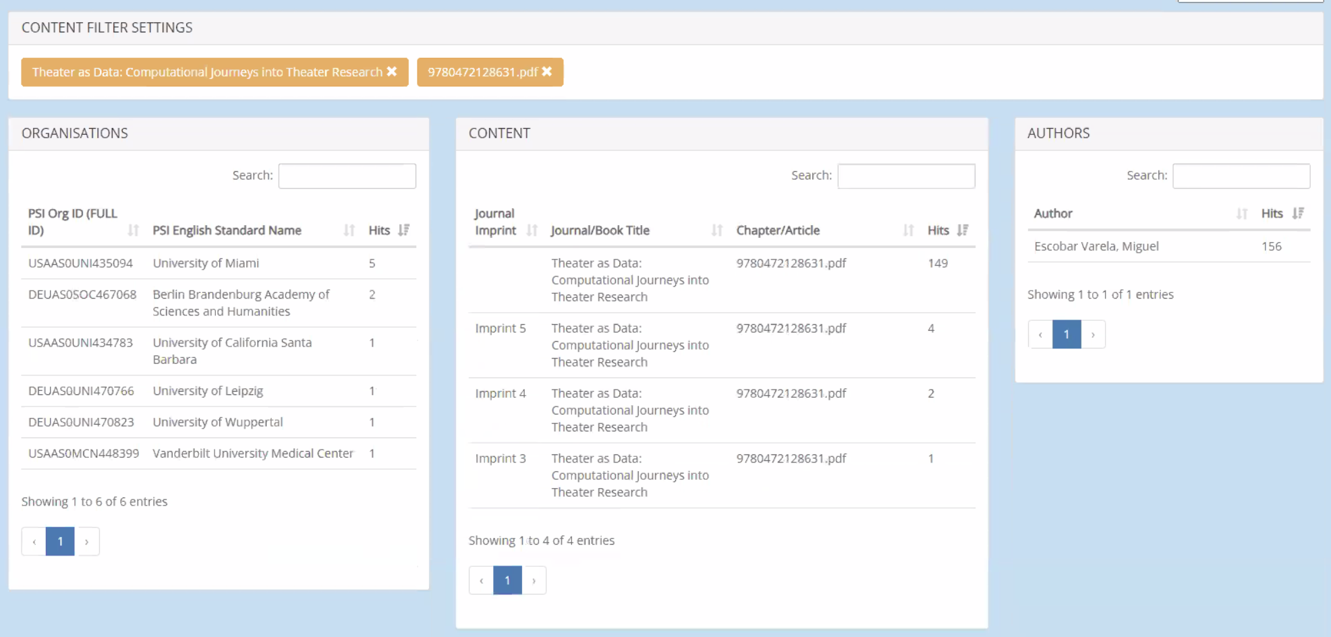
Michigan University Press
Article Report – global usage for a single article

Slide 8
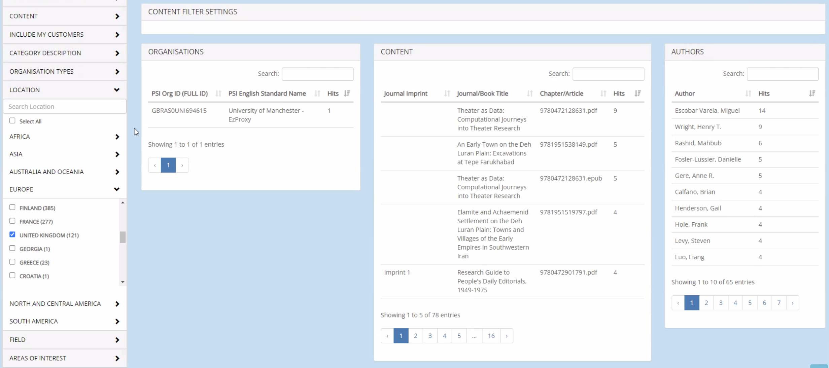
Michigan University Press
Country report – all usage from within a country

Slide 9
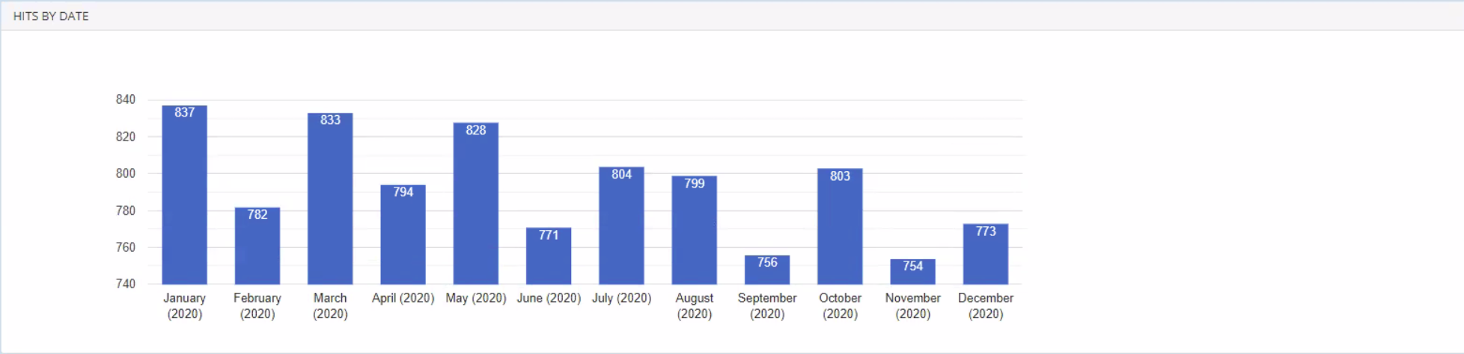
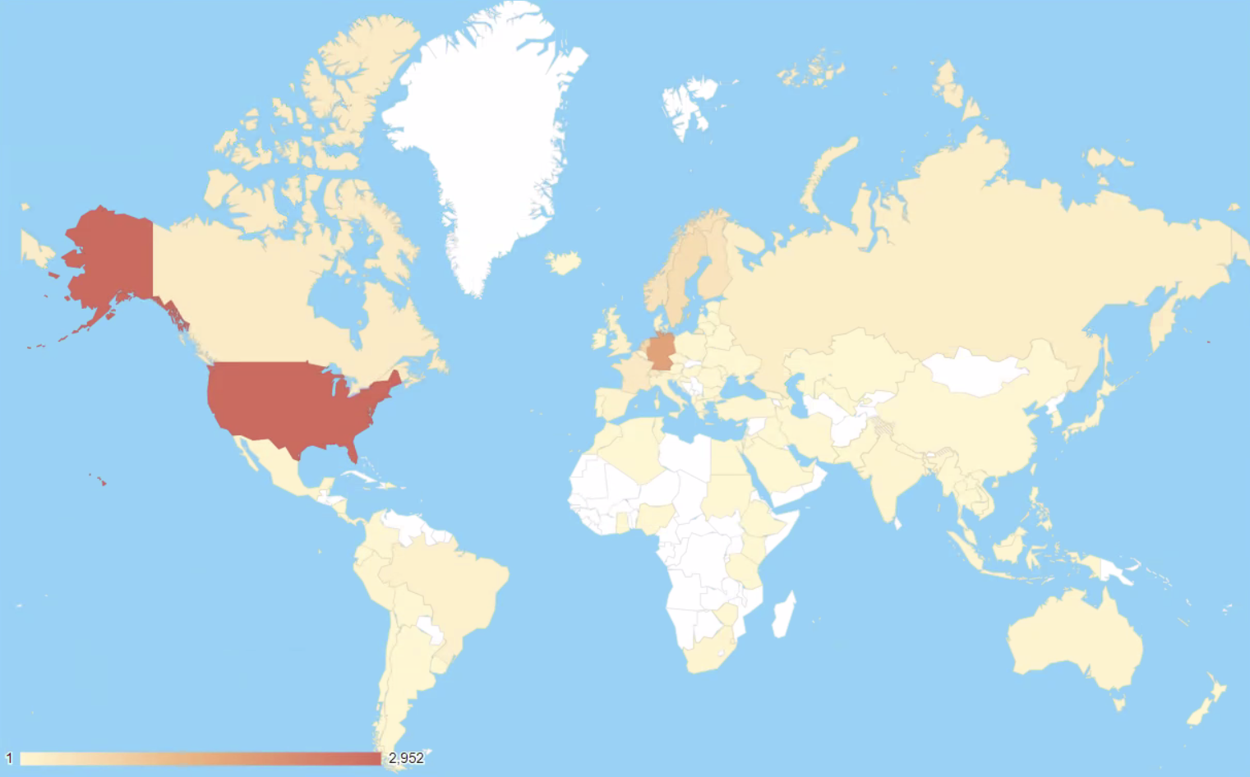
Michigan University Press
Usage over time & heatmap of usage

Slide 10


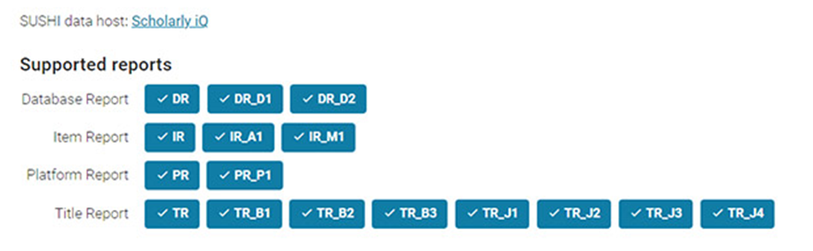
COUNTER standards in OA journals usage reporting
SCHOLARLY IQ
Scholarly iQ – independent leader in usage reporting since 2002. Certified Compliance for All Reports.
COUNTER – supported by libraries, publishers and vendor members for Code of Practice for
Consistent Credible Comparable usage
Latest Consultation for Release 5.1 - Key Propositions to support Open Access usage reporting
Move to Item as unit of reporting
New Data_Types and Access_Types (Controlled/Open/Free_to_Read)
Global usage reports at item level
Link reports to registry to validate compliance
CHALLENGES
Exponential scale of data tables
Audit compliance
Metadata availability
Open data
OPPORTUNITIES
Establish industry agreed standards for OA content performance.
Pivot OA usage reporting to further stakeholders.
Increased trust & transparency in OA publishing
Business insight and analytics driven at item level

Slide 11
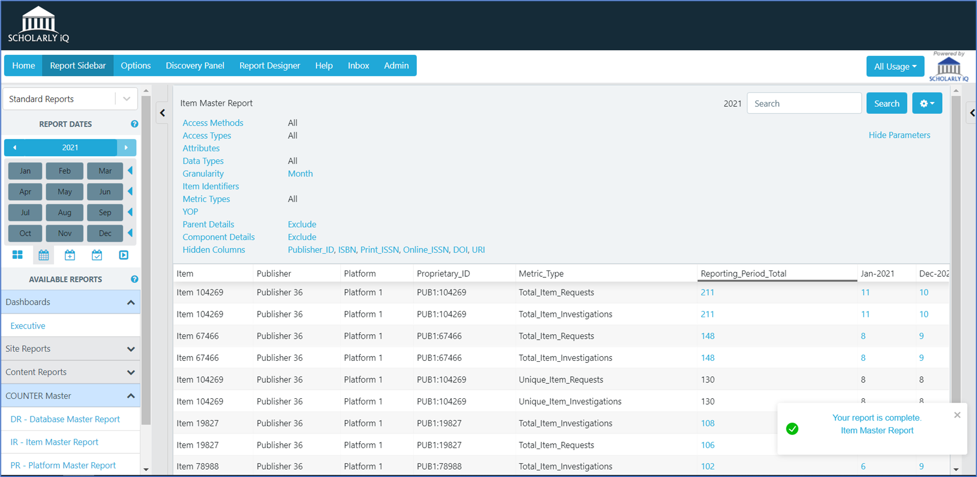
Global Item Level OA Report
COUNTER Compliant Parameters & Metrics

Slide 12
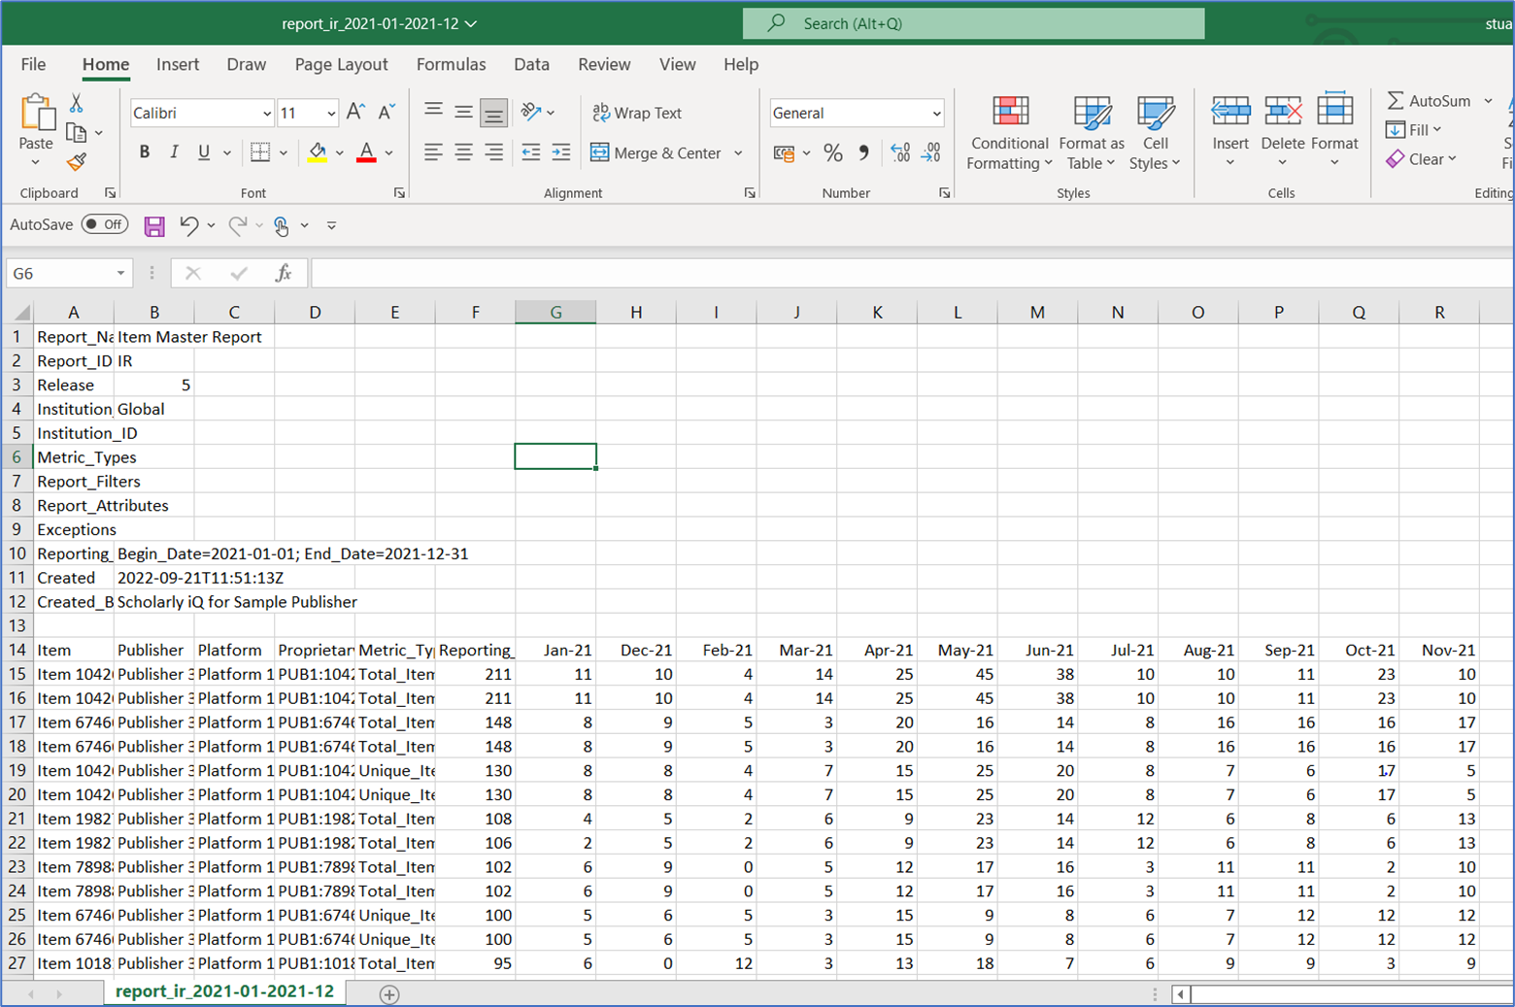
Global Item Level OA Report
COUNTER Compliant Exports & SUSHI

Slide 13
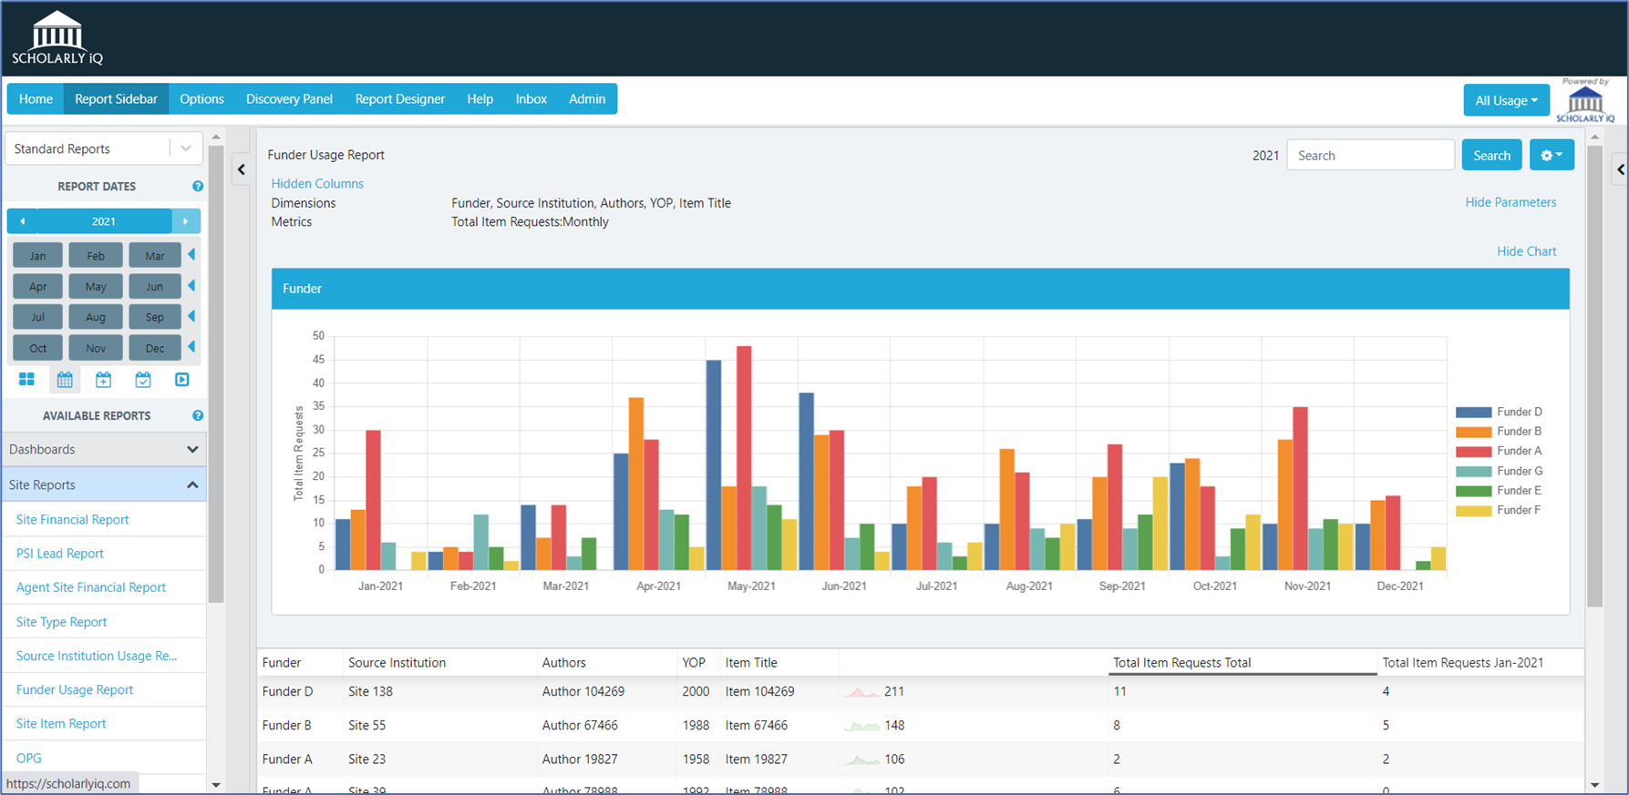
Stakeholder OA Reporting
Example – Trusted Reporting to Funders

Slide 14
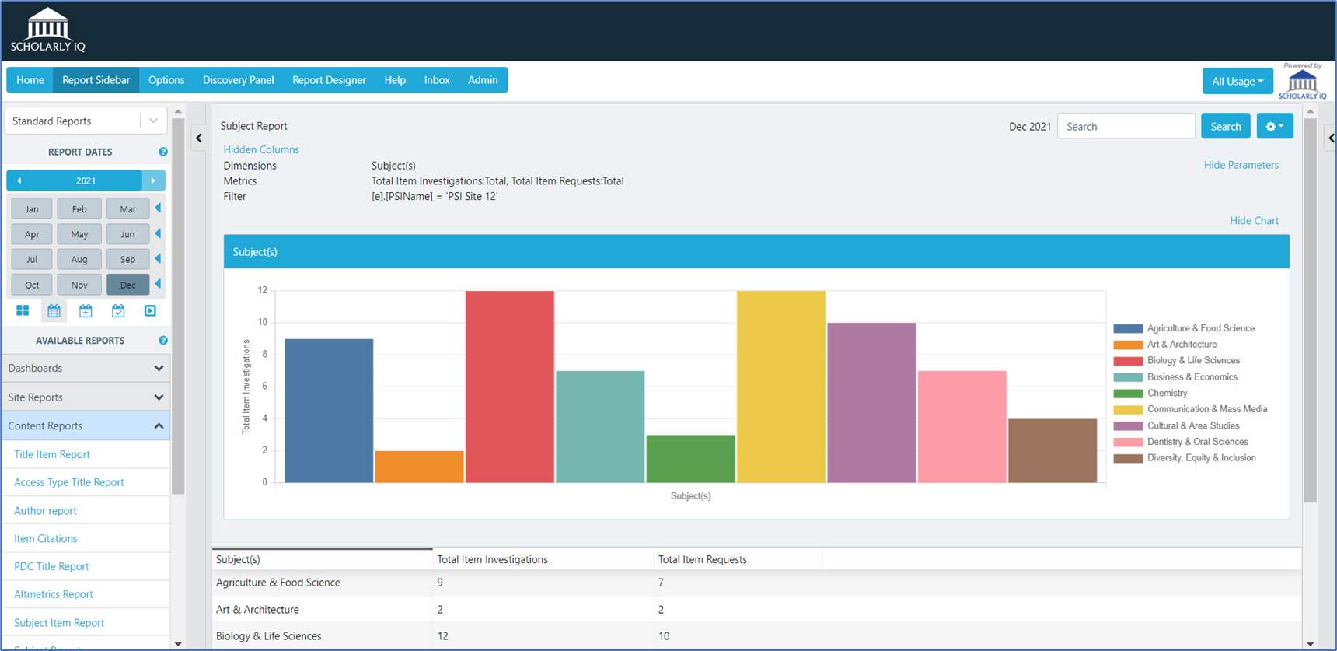
Extended Data & Business Insight
Example – Trusted Item driven OA subject/topic analysis

Slide 15

OA usage for libraries & consortia
Jisc
Jisc Licensing
Negotiates agreements on behalf of the sectors
Includes transitional agreements, fully OA publishers, and self-archiving routes
Needs data and analytics
JUSP (Journal Usage Statistics Portal)
Collects PR, TR and DR (exploring IR)
Present back to libraries through a single portal
Feeds consortium analysis
Currently, institutional OA usage only, but opportunities with COUNTER 5.1
IRUS (Institutional Repository Usage Statistics)
Collect raw usage events and process into COUNTER-conformant statistics
Present global usage at platform and item level
Openly available
A not-for-profit organisation providing digital services and solutions to UK higher education, further education, skills and research.

Slide 16
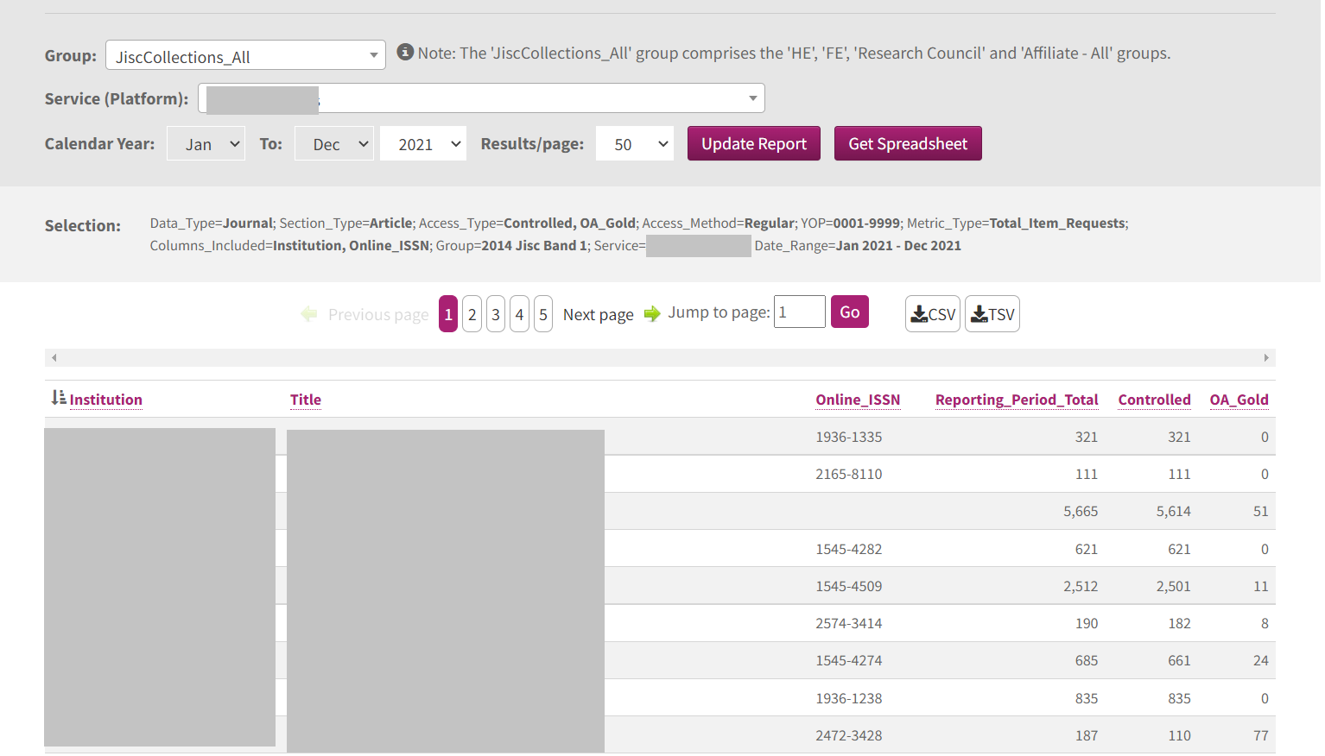
JUSP consortium report
Jisc

Slide 17
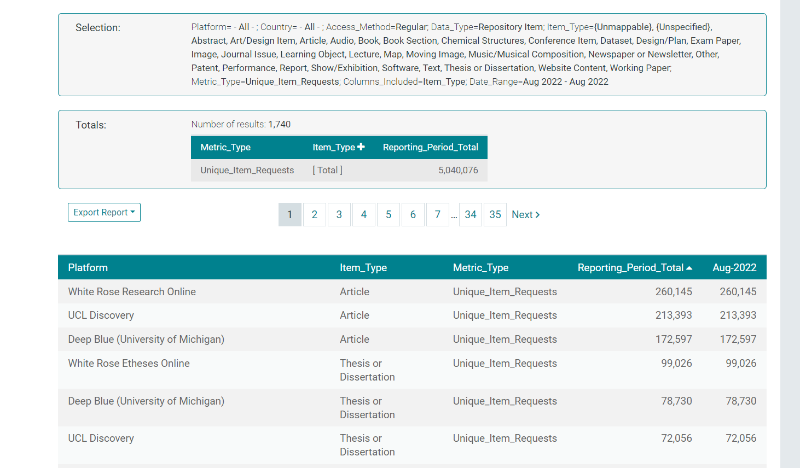
IRUS platform report
Jisc

Slide 18
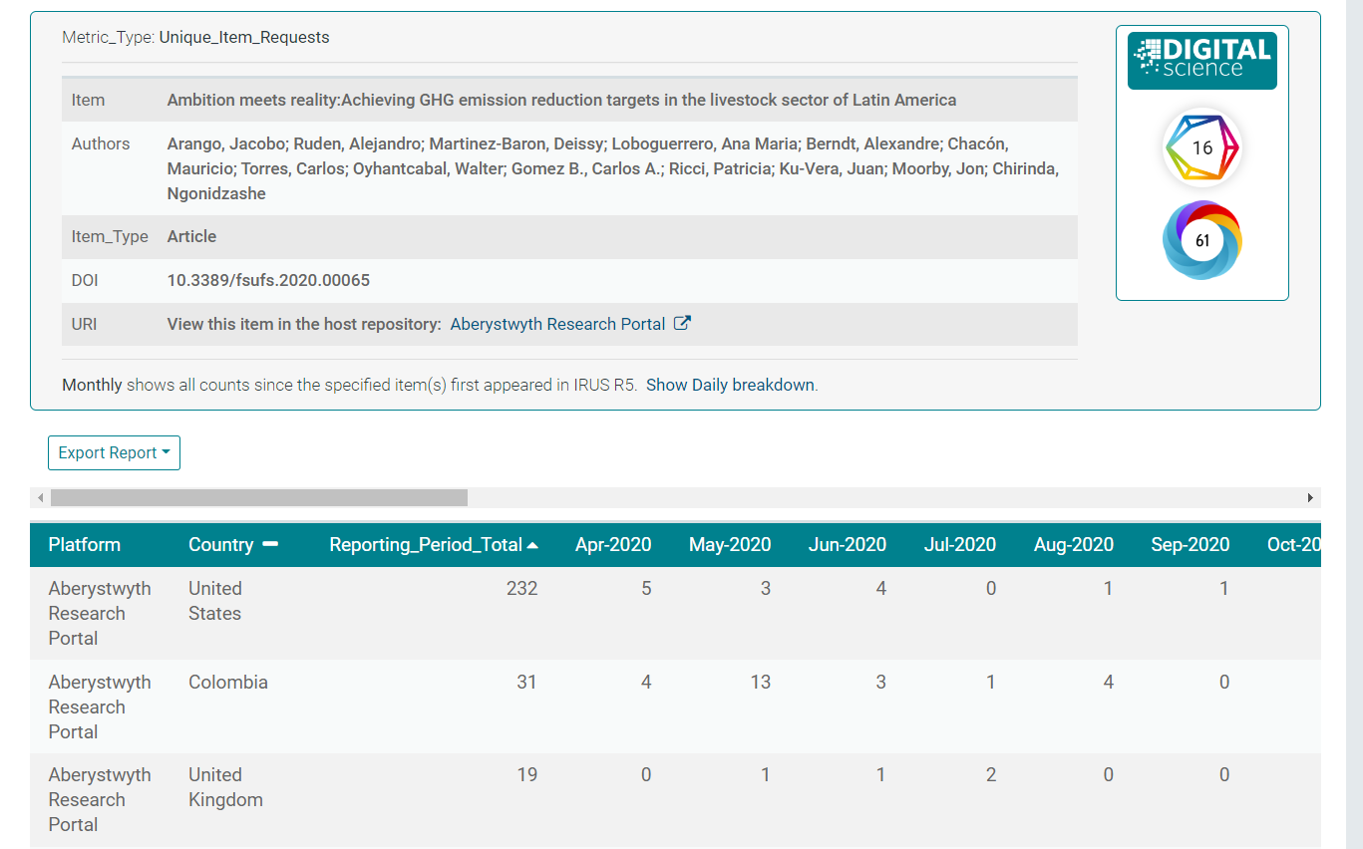
IRUS individual item report
Jisc

Slide 19

Where is the user coming from? Institutional vs global vs robots
Standards and types of metrics to track
DISCUSSION
Use cases for OA usage reports: authors, funders?
How do libraries/consortia use OA usage data to evaluate agreements?
Do we need to look at usage of different versions of articles (repositories, pre-prints)?​
Should usage stats on OA content be openly available? GDPR issues?

Slide 20
WHAT'S NEXT?
Opportunities & challenges
for your organisation & for the industry
Audience Q&A
Notes:
2 mins each on additional plans

Slide 21
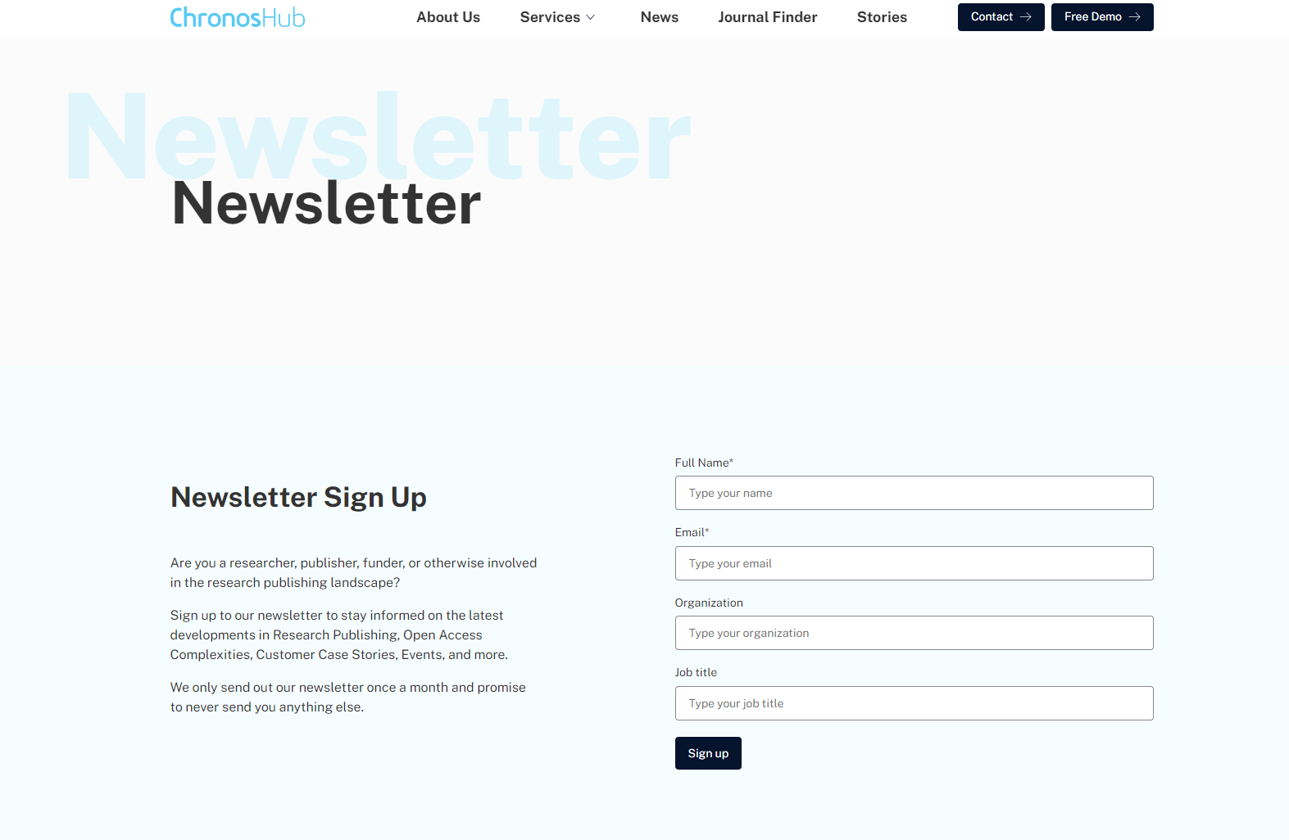
NEWSLETTER &
EVENTS LIST
Sign up for our newsletter to stay informed on the latest developments in research publishing, open access complexities, customer case stories, future webinars, events, and much more.
We only send out our newsletter once a month – less is much more.
Newsletter: https://chronoshub.io/newsletter/
Event list: https://chronoshub.io/events/

Slide 22
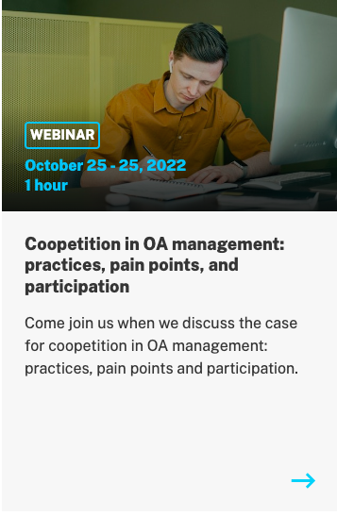
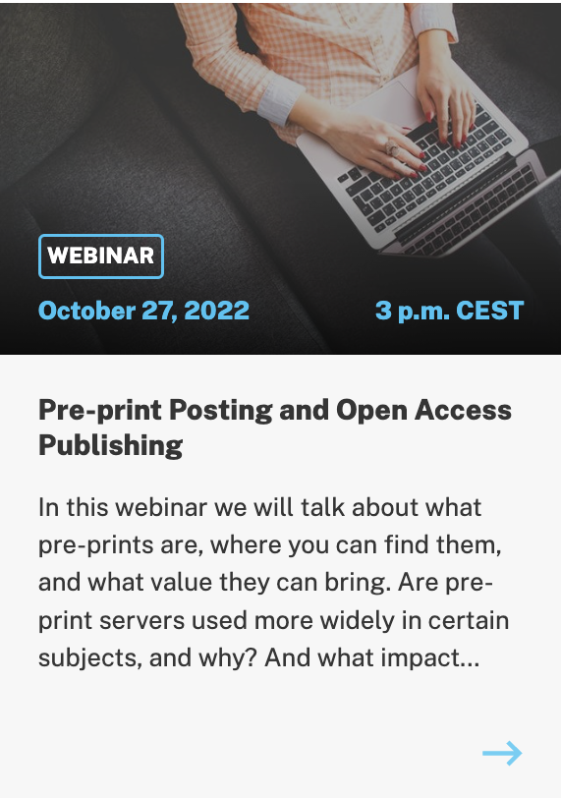
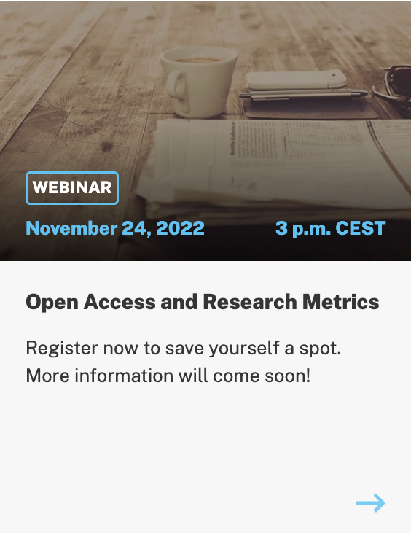
UPCOMING WEBINARS

Slide 23




QUESTIONS
PLEASE GET IN TOUCH
@Chronoslimited
@chronoshub
@chronoshub
Romy Beard
Head of Publisher Relations
rb@chronoshub.io
Notes:
https://chronoshub.io/
https://www.linkedin.com/company/chronoshub/posts/?feedView=all
https://www.facebook.com/chronoslimited
https://twitter.com/chronoshub?lang=ca
Facebook: @Chronoslimeted
Andet @chronoshub

